Slide 1



Journey PPT
Tanishqa Aggarwal
19 Sep 2023 - 22 Sep 2023
Week 5

Slide 2
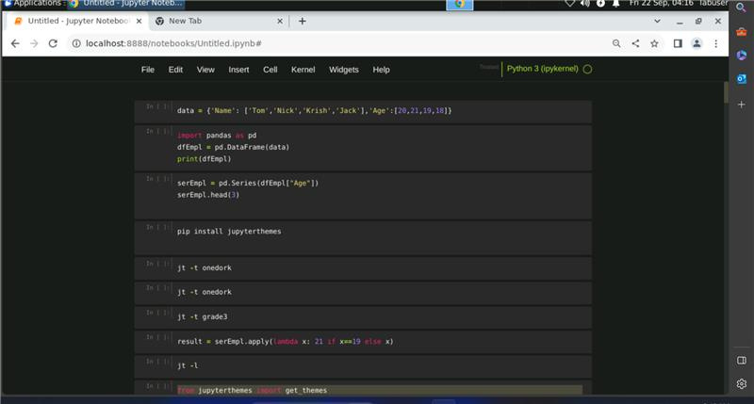
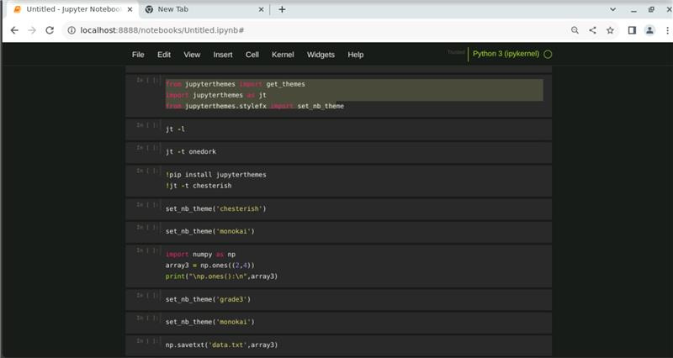
Day 1
19 Sep 2023
Python
Working with pandas and numpy

Slide 3
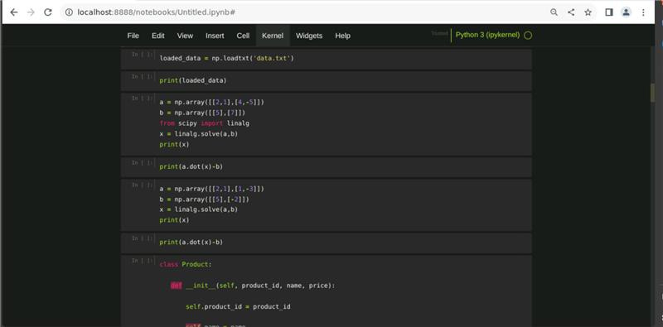
Day 1
19 Sep 2023
Python
Working with data

Slide 4
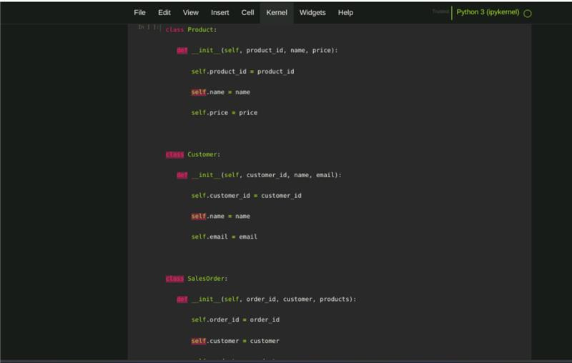
Day 1
19 Sep 2023
Python
Working with Functions

Slide 5

Day 2
20 Sep 2023
PySpark
PySpark is the Python library for Apache Spark, an open-source, distributed computing system designed for big data processing and analytics. Spark provides an easy-to-use and versatile framework for processing large datasets in parallel across a cluster of computers. PySpark allows you to interact with Spark using Python, making it more accessible to Python developers.

Slide 6
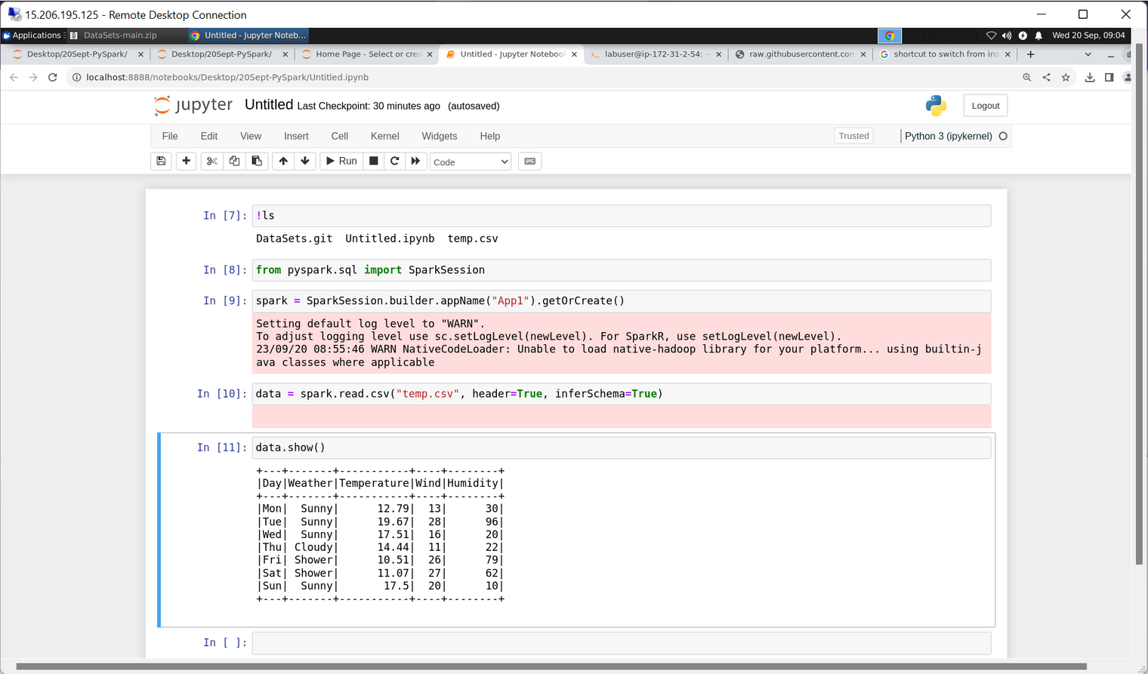
Day 2
20 Sep 2023
PySpark
Creating Spark Session

Slide 7
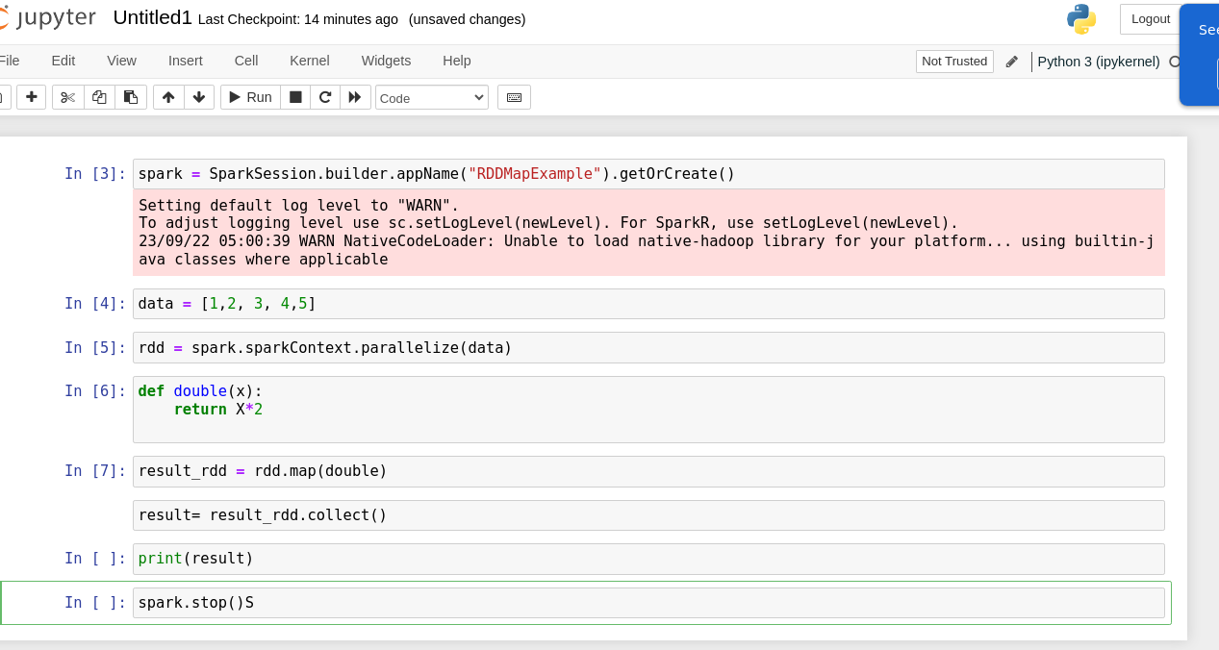
Day 3
21 Sep 2023
PySpark
Creating a RDD

Slide 8
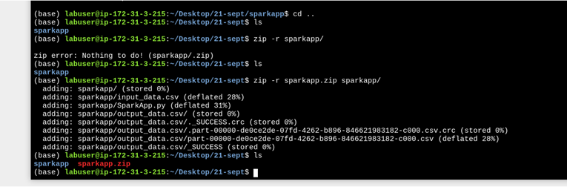
Day 3
21 Sep 2023
PySpark
Generating Zip

Slide 9
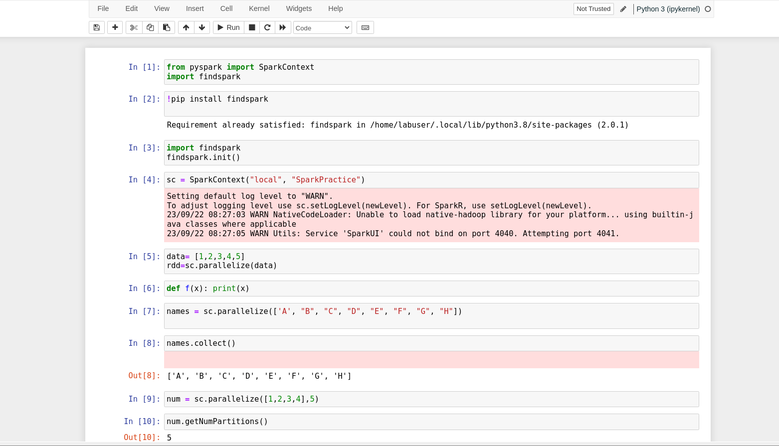
Day 4
22 Sep 2023
PySpark
Working on Dataset

Slide 10
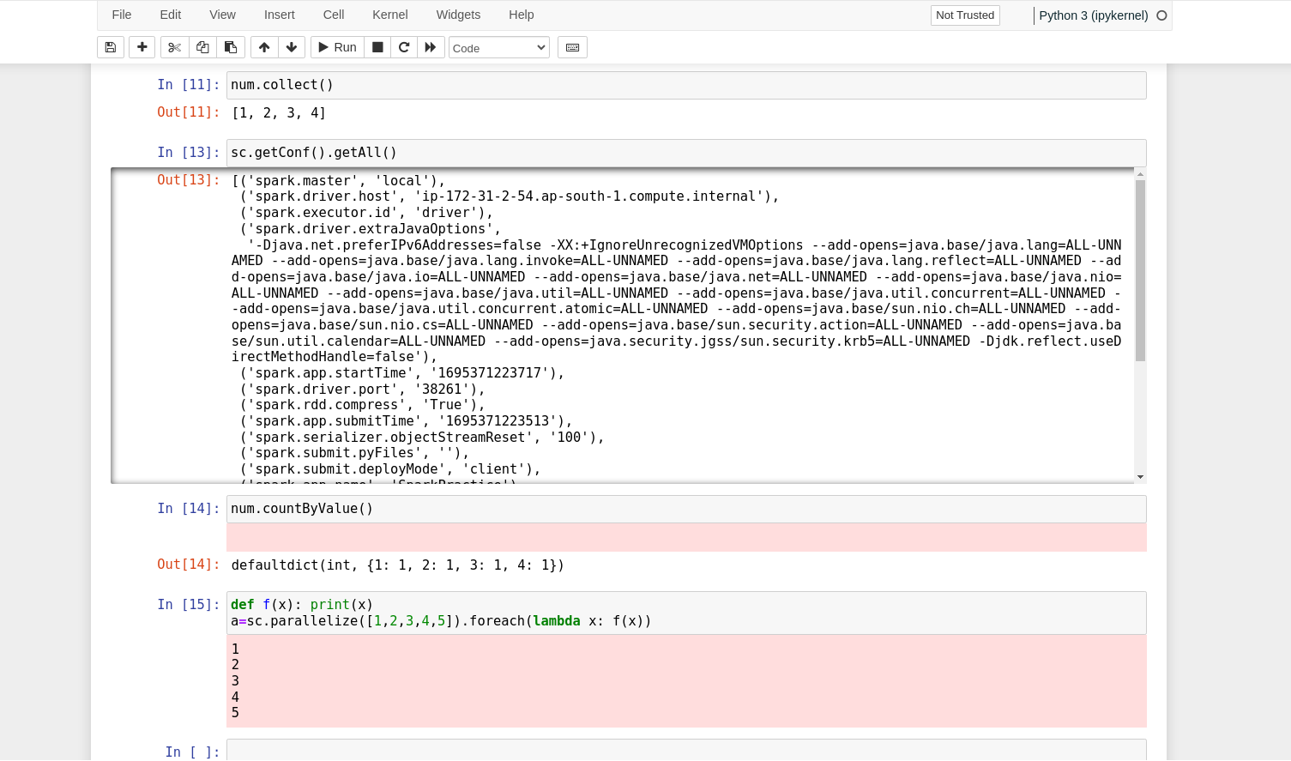
Day 4
22 Sep 2023
PySpark
Working on Dataset

Slide 11
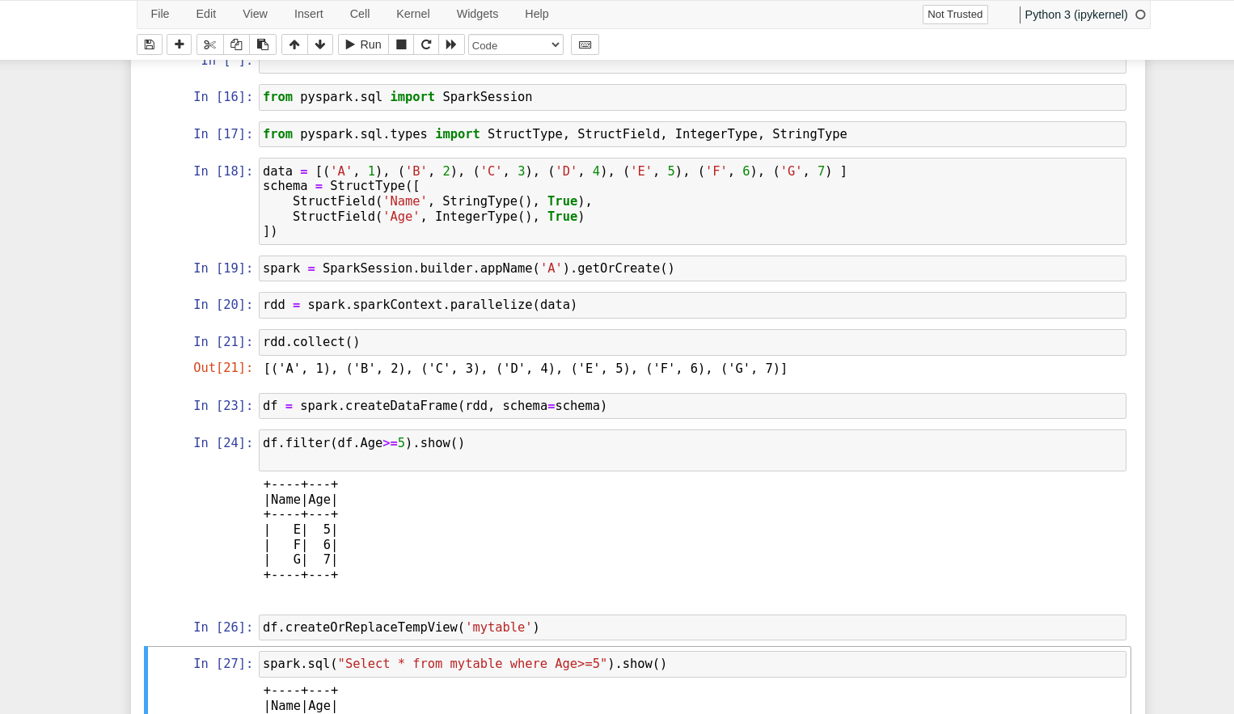
Day 4
22 Sep 2023
PySpark
Working with high level view of data using SQL like commands

Slide 12
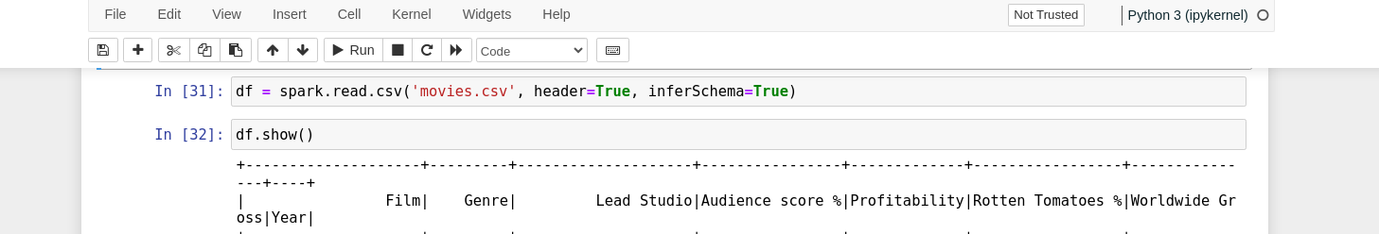
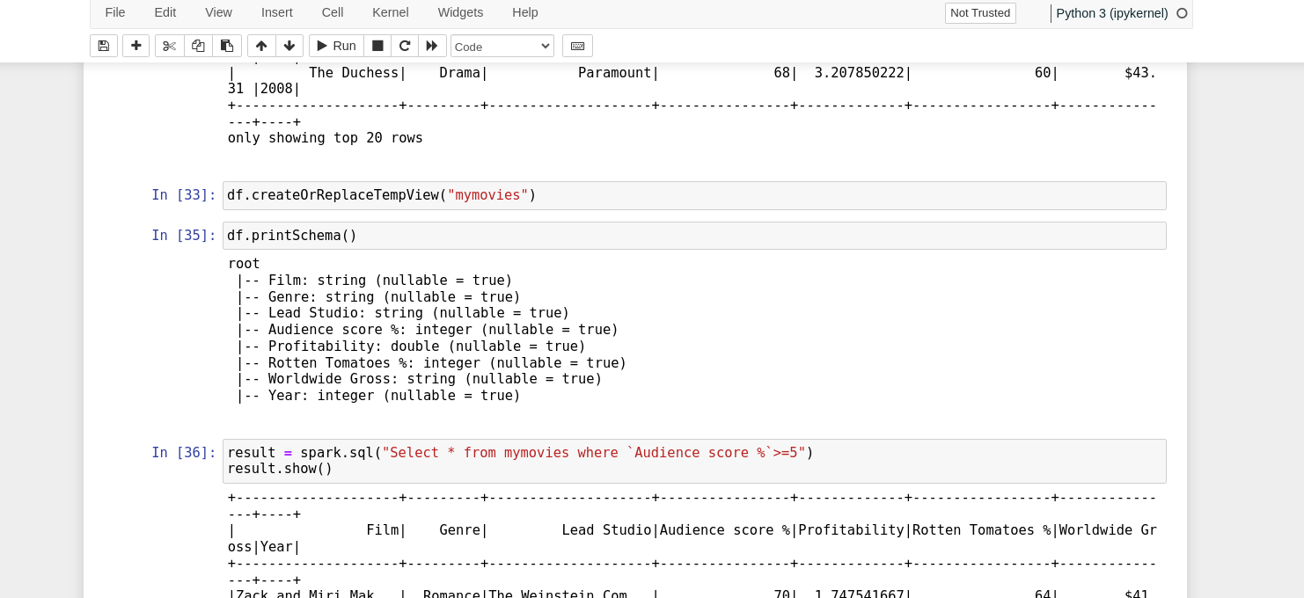
Day 4
22 Sep 2023
PySpark
Working with high level view of data using SQL like commands

Slide 13

Thank You

